Slide 1
JQUERY
Introduction to JQuery
Syntax
Selectors
Events
JQuery HTML
JQuery Effects
JQuery CSS

Slide 2
INTRODUCTION TO JQUERY
jQuery is a lightweight, "write less, do more", JavaScript library.
jQuery greatly simplifies JavaScript programming.
jQuery is easy to learn. Before start – HTML, CSS and JavaScript.
The purpose of jQuery is to make it much easier to use JavaScript on your website.
jQuery takes a lot of common tasks that require many lines of JavaScript code to accomplish, and wraps them into methods that you can call with a single line of code.
jQuery also simplifies a lot of the complicated things from JavaScript, like AJAX calls and DOM manipulation.
The jQuery library contains the following features:
HTML/DOM manipulation
CSS manipulation
HTML event methods
Effects and animations
AJAX and Utilities

Slide 3
Why we learn jQuery ?
There are lots of other JavaScript libraries out there, but jQuery is probably the most popular, and also the most extendable.
Many of the biggest companies on the Web use jQuery, such as:
Google
Microsoft
IBM
Netflix
Will jQuery work in all browsers? - The jQuery team knows all about cross-browser issues, and they have written this knowledge into the jQuery library.
jQuery will run exactly the same in all major browsers.

Slide 4
There are several ways to start using jQuery on your web site.
You can: Download the jQuery library from jQuery.com.
Include jQuery from a CDN(Content Delivery Network), like Google Downloading jQuery.
There are two versions of jQuery available for downloading:
Production version - this is for your live website because it has been minimize and compressed.
Development version - this is for testing and development (uncompressed and readable code).
Both versions can be downloaded from jQuery.com.

Slide 5
JQuery Syntax
The jQuery syntax is tailor-made for selecting HTML elements and performing some action on the element(s).
Basic syntax is: $(selector).action()
A $ sign to define/access jQuery
A (selector) to "query (or find)" HTML elements
A jQuery action() to be performed on the element(s)
Examples:
$(this).hide() - hides the current element.
$("p").hide() - hides all <p> elements.
$(".test").hide() - hides all elements with class="test".
$("#test").hide() - hides the element with id="test".

Slide 6
JQUERY SELECTORS
Accessing HTML elements is one of jQuery’s biggest strengths.
jQuery uses selectors that are very similar to CSS selectors to access one or more elements in the DOM; hence the name jQuery.
jQuery returns back either a single element or an array of jQuerified objects. jQuerified means that additional jQuery functionality has been added to the DOM object, allowing for much easier manipulation.
The syntax for using jQuery selectors is,
$(selector).action()
where selector is replaced by a valid selector.
action is replaced by a jQuerified action attached to the DOM element(s).
For example, the following command finds all paragraph elements in the HTML document and sets the CSS font-weight property to bold,
$("p").css('font-weight', 'bold');

Slide 7
Event Handlers in jQuery
Using jQuery objects makes it simple to select different sets of objects and apply the same event handler to all of them at the same time.
jQuery has had a couple of ways to add and remove event handlers, including bind()/unbind() and delegate()/undelegate().
The bind() method is similar to the behavior of addEventListener(), and
delegate() made it possible to add an event to a jQuery object.
Event handlers are attached to jQuery objects using the on() method. The on() method can be called in one of the two following formats:
on(events [, selector] [, data], handler(eventObject))
on(events-map [, selector][, data])

Slide 8
Added to the on() method when adding event handlers to jQuery objects:
events—One or more space-separated event types and optional namespaces denoted by dot syntax;
for example, "click", "mouseenter mouseleave", or "keydown.myPlugin".
events-map—A mapping object in which the string keys specify one or more space-separated event types, and then the values specify handler functions that will be called when the event is triggered;
for example, {'click':myhandler} or {'click':function myHandler(e){return true;}}.
selector—Optional. Selector string that specifies which descendants should also call the event handler when the event is triggered. This replaces the functionality of the delegate() method.
data—Optional. This can be a number, a string, or an object that will get passed to the handler as the data part of the event as event, data when an event is triggered.

Slide 9
To remove an event handler from elements using jQuery, call the off() method on the jQuery object.
The syntax for the off method is one of the following:
off(events [, selector] [, handler(eventObject]))
off(events-map [, selector])
JQUERY HTML
The html() method sets or returns the content (innerHTML) of the selected elements.
When this method is used to return content, it returns the content of the FIRST matched element.
When this method is used to set content, it overwrites the content of ALL matched elements.
Syntax
Return content:
$(selector).html()
Set content:
$(selector).html(content)
Set content using a function:
$(selector).html(function(index,currentcontent))

Slide 10
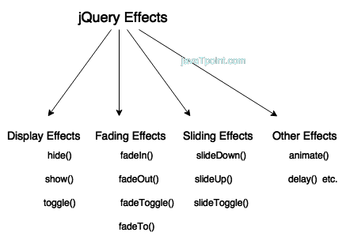
JQUERY EFFECTS
jQuery enables us to add effects on a web page. jQuery effects can be categorized into fading, sliding, hiding/showing and animation effects.

Slide 11
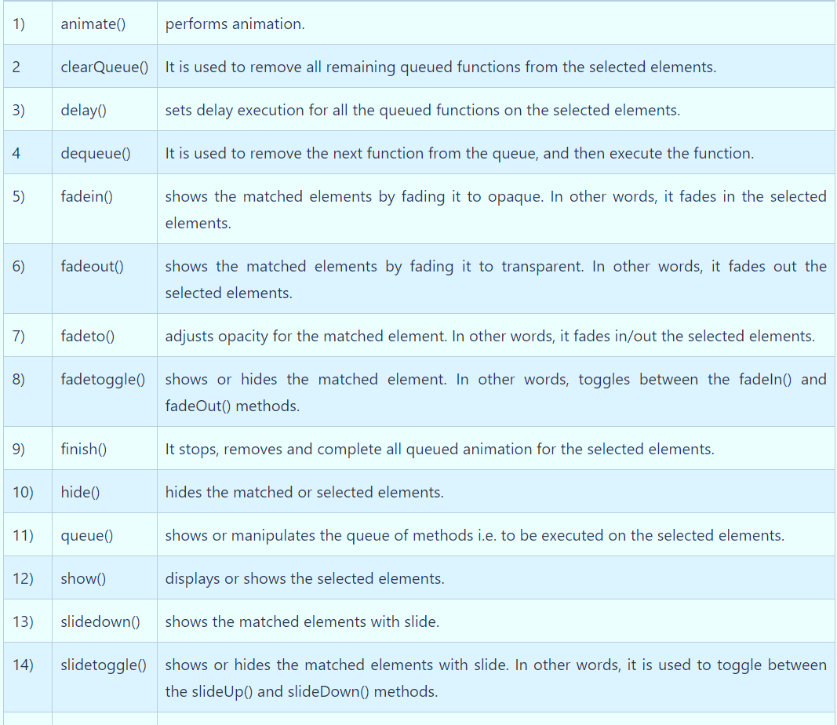
jQuery provides many methods for effects on a web page. A complete list of jQuery effect methods are given below:

Slide 12
Jquery CSS
css() method sets or returns one or more style properties for the selected elements.
Return a CSS Property
To return the value of a specified CSS property, use the following syntax:
css("propertyname");
The following example will return the background-color value of the FIRST matched element:
Example
$("p").css("background-color");
Set a CSS Property
To set a specified CSS property, use the following syntax:
css("propertyname","value");
The following example will set the background-color value for ALL matched elements:
Example
$("p").css("background-color", "yellow");

Slide 13
Set Multiple CSS Properties
To set multiple CSS properties, use the following syntax:
css({"propertyname":"value","propertyname":"value",...});
The following example will set a background-color and a font-size for ALL matched elements:
Example
$("p").css({"background-color": "yellow", "font-size": "200%"});

Slide 14
Introduction to Angular JS
Directives
Expressions
Controllers
Filters
Services
Events
Forms
Validations – Examples.

Slide 15
INTRODUCTION TO ANGULAR JS
AngularJS is an open-source web application framework.
It was originally developed in 2009 by Misko Hevery and Adam Abrons.
General Features
The general features of AngularJS are as follows −
AngularJS is a efficient framework that can create Rich Internet Applications (RIA).
A rich internet application (RIA) refers to the technologies that let organizations build applications for rich, responsive user experiences.
AngularJS provides developers an options to write client side applications using JavaScript in a clean Model View Controller (MVC) way. Model-view-controller (MVC) is an architectural design pattern that organizes an application's logic into distinct layers.
Applications written in AngularJS are cross-browser compliant. AngularJS automatically handles JavaScript code suitable for each browser.
AngularJS is open source, completely free, and used by thousands of developers around the world. It is licensed under the Apache license version 2.0.

Slide 16
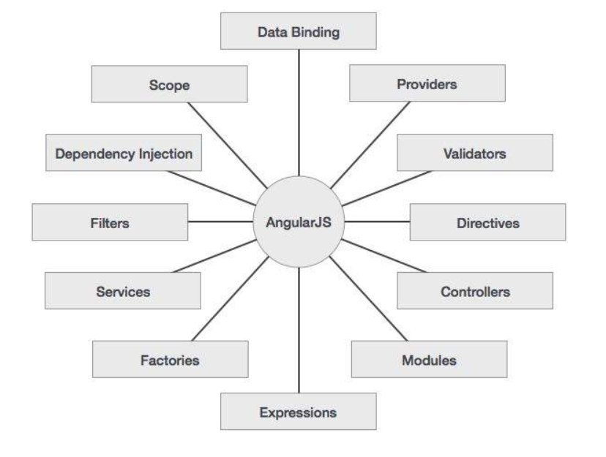

Slide 17
ADVANTAGES:
It provides the capability to create Single Page Application in a very clean and maintainable way.
It provides data binding capability to HTML. Thus, it gives user a rich and responsive experience.
AngularJS code is unit testable.
AngularJS uses dependency injection and make use of separation of concerns. Programming technique in which an object or function receives other objects or functions that it requires.
AngularJS provides reusable components.
With AngularJS, the developers can achieve more functionality with short code.
In AngularJS, views are pure html pages, and controllers written in JavaScript do the business processing.

Slide 18
DISADVANTAGES:
Not Secure − Being JavaScript only framework, application written in AngularJS are not safe. Server side authentication and authorization is must to keep an application secure.
Not degradable − If the user of your application disables JavaScript, then nothing would be visible, except the basic page.

Slide 19
AngularJS Directives
AngularJS lets you extend HTML with new attributes called Directives.
AngularJS has a set of built-in directives which offers functionality to your applications.
AngularJS also lets you define your own directives.
AngularJS directives are extended HTML attributes with the prefix ng-.
The ng-app directive initializes an AngularJS application.
The ng-init directive initializes application data.
The ng-model directive binds the value of HTML controls (input, select, text area)
to application data.
ng-repeat: This directive repeats html elements for each item in a collection.
Example
<div ng-app="" ng-init="firstName='John'"> <p>Name: <input type="text" ng-model="firstName"></p> <p>You wrote: {{ firstName }}</p> </div>

Slide 20
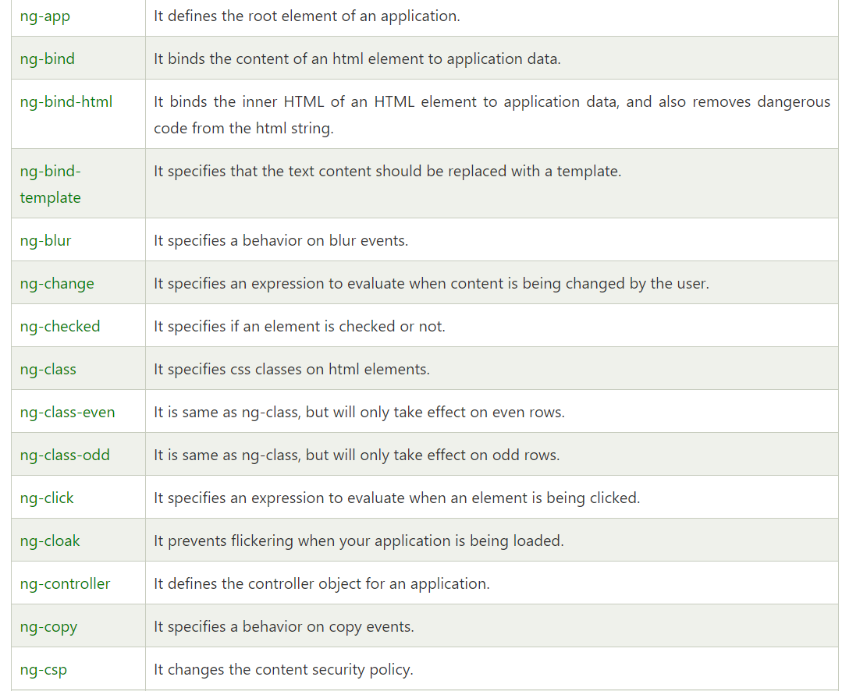

Slide 21
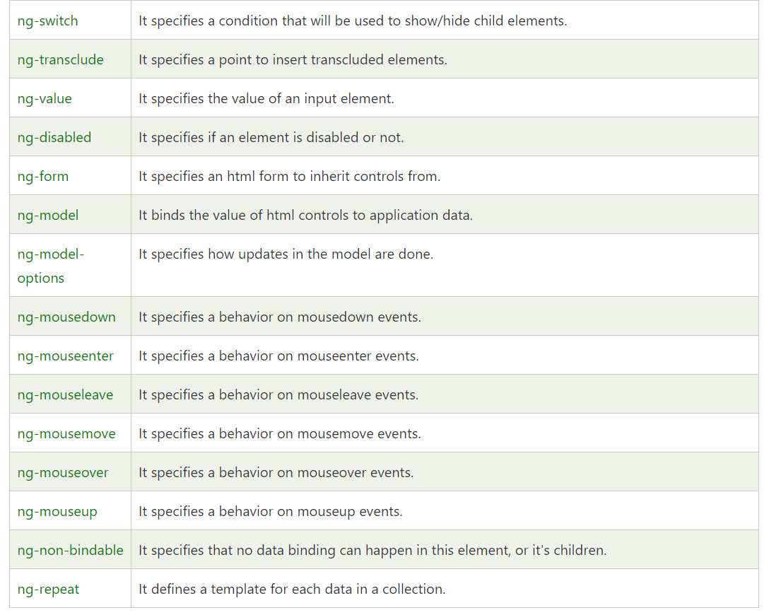

Slide 22
EXPRESSIONS
Using Expressions is the simplest way to represent data from the scope in an AngularJS view.
Expressions are encapsulated blocks of code inside brackets: {{expression}}.
The AngularJS compiler compiles an expression into HTML elements so that the results of the expression are displayed.
For example, look at the following expressions: {{1+5}} {{'One' + 'Two'}}
Based on those expressions, the web page displays these values:
6
OneTwo
Expressions are bound to the data model, which provides two huge benefits.
First, you can use the property names and functions that are defined in the scope inside your expressions.
Second, because the expressions are bound to the scope, when data in the scope changes, so do the expressions.
For example, suppose that the scope contains the following values: $scope.name='Brad'; $scope.score=95;

Slide 23

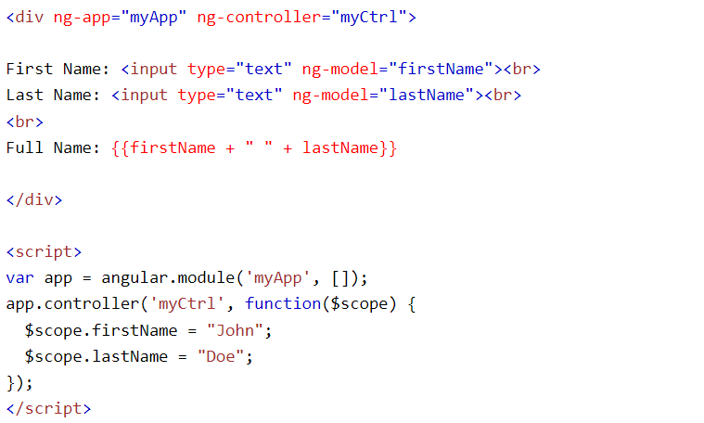
AngularJS evaluates the strings used to define the value of attributes in directive tags as expressions. This enables you to include expression-type syntax within a definition. For example, when you set the value of the ng-click directive in the template, you specify an expression.
CONTROLLERS
AngularJS controllers control the data of AngularJS applications.
AngularJS controllers are regular JavaScript Objects.
AngularJS applications are controlled by controllers.

Slide 24
The ng-controller directive defines the application controller.
A controller is a JavaScript Object, created by a standard JavaScript object constructor.
The AngularJS application is defined by ng-app="myApp". The application runs inside the <div>.
The ng-controller="myCtrl" attribute is an AngularJS directive. It defines a controller.
The myCtrl function is a JavaScript function.
AngularJS will invoke the controller with a $scope object.
In AngularJS, $scope is the application object (the owner of application variables and functions).
The controller creates two properties (variables) in the scope (firstName and lastName).
The ng-model directives bind the input fields to the controller properties (firstName and lastName).

Slide 25
FILTERS
Using Filters A great feature of AngularJS is the capability to implement filters.
Filters are a type of provider that hooks into the expression parser and modifies the results of the expression for display in a view—for example, to format time or currency values.
You implement filters inside expressions, using the following syntax: {{ expression | filter}} If you chain multiple filters together, they are executed in the order in which you specify them: {{ expression | filter | filter }}
Some filters allow you to provide input in the form of function parameters. You add these parameters by using the following syntax:
{{ expression | filter:parameter1:parameter2 }}
SERVICES
AngularJS services are single to n objects, which means only one instance is ever created.
The intent of a service is to provide a concise bit of code that performs specific tasks.
A service can be as simple as providing a value definition or as complex as providing full HTTP communication to a web server.

Slide 26
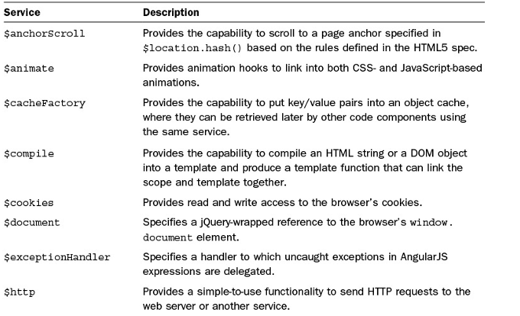
A service provides a container for reusable functionality that is readily available to AngularJS applications.
Services are defined and registered with the dependency injection mechanism in AngularJS.
This enables you to inject services into modules, controllers, and other services.

Slide 27
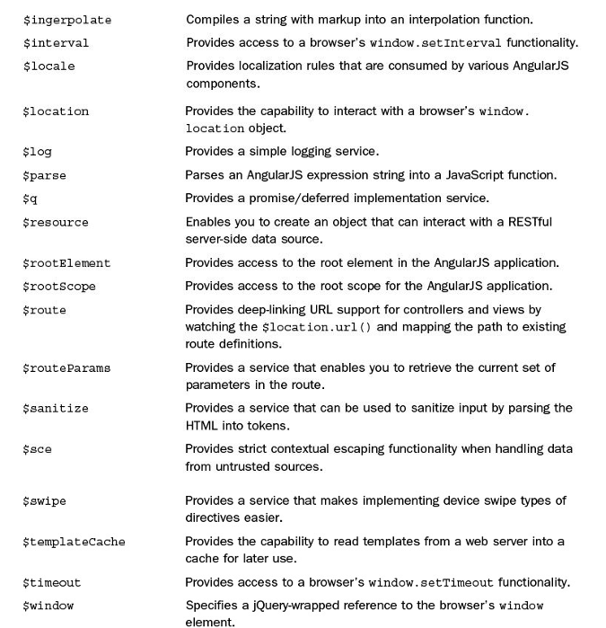

Slide 28
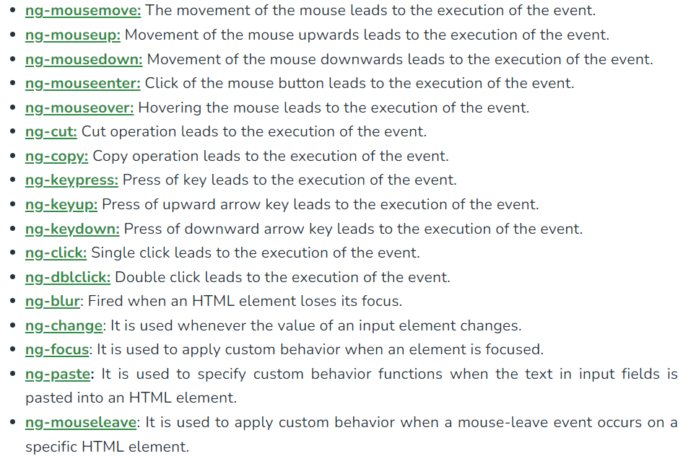
EVENTS
An Events in AngularJS can be used to perform particular tasks, based on the action taken.
Both Angular Event & the HTML Event will be executed & will not overwrite with an HTML Event

Slide 29
FORMS
Forms in AngularJS provides data-binding and validation of input controls.
Input Controls
Input controls are the HTML input elements:
input elements
select elements
button elements
textarea elements
Data-Binding
Input controls provides data-binding by using the ng-model directive.
<input type="text" ng-model="firstname">
The application does now have a property named firstname.
The ng-model directive binds the input controller to the rest of your application.
Checkbox
A checkbox has the value true or false. Apply the ng-model directive to a checkbox.
<input type="checkbox" ng-model="myVar">

Slide 30
RADIO BUTTONS
Bind radio buttons to your application with the ng-model directive.
Radio buttons with the same ng-model can have different values, but only the selected one will be used.
<form> Pick a topic: <input type="radio" ng-model="myVar" value="dogs">Dogs <input type="radio" ng-model="myVar" value="tuts">Tutorials <input type="radio" ng-model="myVar" value="cars">Cars </form>
Selectbox
Bind select boxes to your application with the ng-model directive.
The property defined in the ng-model attribute will have the value of the selected option in the selectbox.
<form> Select a topic: <select ng-model="myVar"> <option value=""> <option value="dogs">Dogs <option value="tuts">Tutorials <option value="cars">Cars </select> </form>

Slide 31
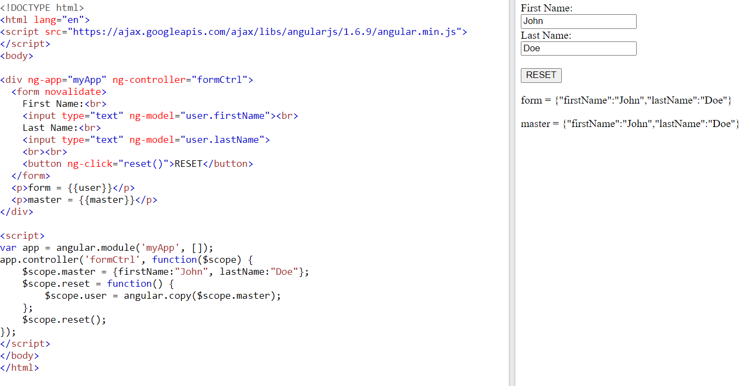
An AngularJS Form Example

Slide 32
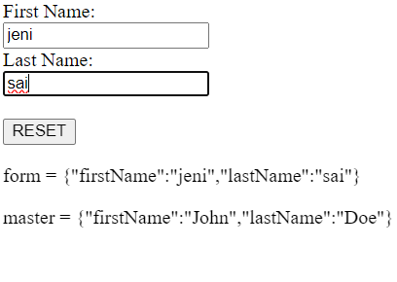
The ng-app directive defines the AngularJS application.
The ng-controller directive defines the application controller.
The ng-model directive binds two input elements to the user object in the model.
The formCtrl controller sets initial values to the master object, and defines the reset() method.
The reset() method sets the user object equal to the master object.
The ng-click directive invokes the reset() method, only if the button is clicked.

Slide 33
